Slide 1

STAT 535 Team Project Analysis of Seasonal Temperature Variability Using Bootstrap and Monte Carlo Methods
Marco Lopez Aiden Nguyen Jerry Obour Shumeng Zhang

Slide 2
Contents
Introduction
Research Question and Hypothesis
Objectives
Methods
Results & Discussion
Conclusion

Slide 3
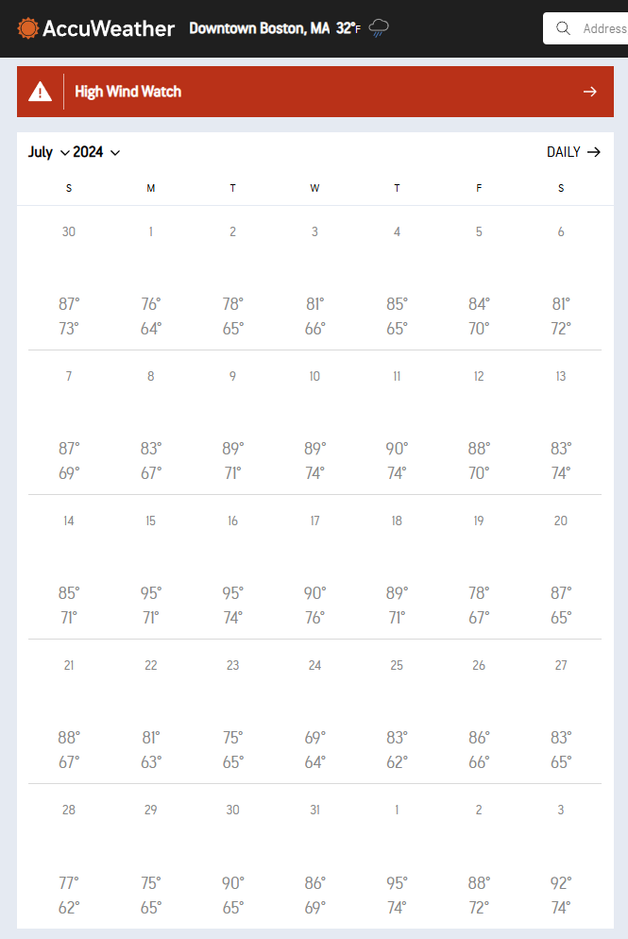
Introduction
Topic:
Comparative Analysis of Seasonal Temperature Variability in Boston and Amherst
Using Bootstrap and Monte Carlo Methods
Data source:
Accuweather.com
https://www.accuweather.com/en/us/downtown-boston/02108/june-weather/2626565
Information of dataset:
4 variables: Date, Week, High Temperature, Low Temperature
Goal:
Use daily high temperature data to determine whether one city experiences higher or lower average temperatures in winter and summer.

Slide 4
Research Question & Hypothesis
Research Question and Hypothesis
Research Question:
Is there a significant difference in the average summer and winter temperatures
between Amherst and Boston?
Hypothesis:
µA = µB
µA ≠ µB
Notes:
Marco

Slide 5
Objectives
Objectives
Use Bootstrapping to assess if there is a significant difference in the average summer and winter temperatures between Amherst and Boston.
Perform a Monte Carlo simulation and conduct a Power Study to estimate the robustness of the observed mean temperature difference between Amherst and Boston.
Notes:
Marco

Slide 6
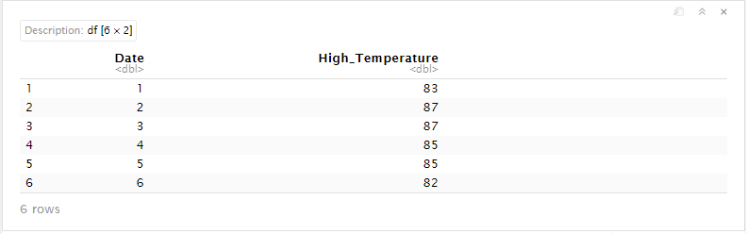
Methods
Data Processing:
Load HTML data and scrape important details
dates and temperatures.
Create a new data frame
Amherst Summer
Boston Summer

Slide 7
Methods
2. Bootstrap Sampling and Hypothesis Testing
Setup Variables:
Ensure both data are of equal length
Set alpha = 0.05
Bootstrap sampling:
Set up sampling indices ‘var_name’
Use ‘var_name’ to sample from both data
Hypothesis Test
Perform a two sample t-test with alpha level of significance.
Construct a 95% confidence interval and record results
Notes:
Marco

Slide 8
Methods
Bootstrap analysis of temperature data
Bootstrap simulation: Generated 10,000 bootstrap samples to estimate the distribution of difference in high temperature means between Amherst and Boston.
Confidence Interval: A 95% confidence interval for difference in means was calculated (blue lines).
Mean difference: The mean difference between the two cities was calculated (red line).
Notes:
Marco

Slide 9
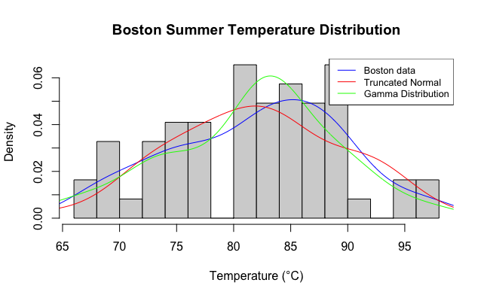
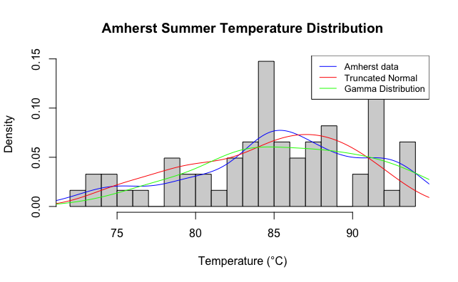
Methods
3. Monte-Carlo and Power Analysis
Study the distribution of the data for simulation

Slide 10
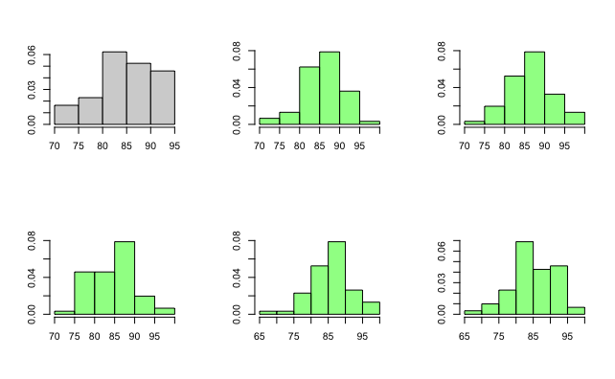
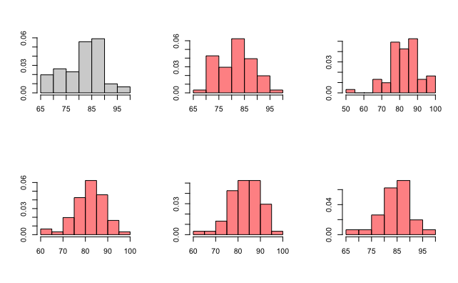
Methods
Studying Distribution of data - Truncated Normal
Amherst data
Boston data

Slide 11
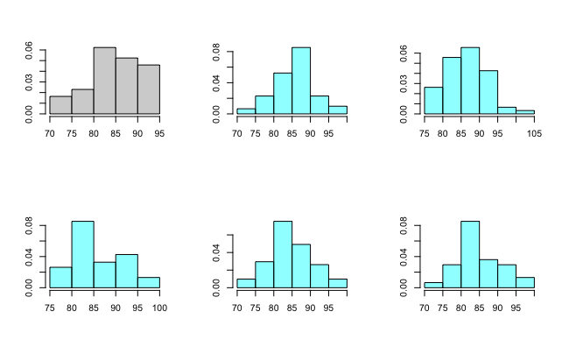
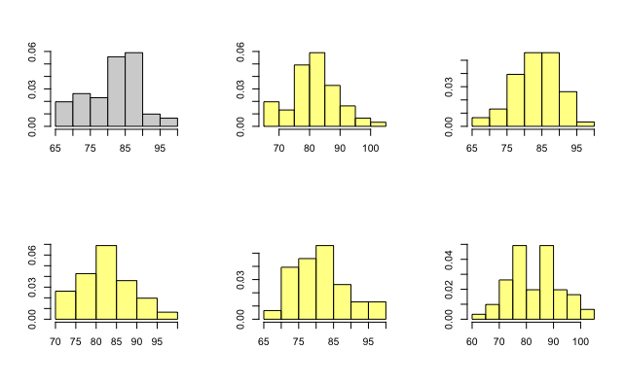
Methods
Studying Distribution of data - Gamma Distribution
Amherst data
Boston data

Slide 12
Methods
Choice of Distribution
Truncated Normal / Gamma.
Assumptions:
Skewness in the distribution of data is not extreme
Average temperature in the summer for both cities is in the range [40,100]

Slide 13
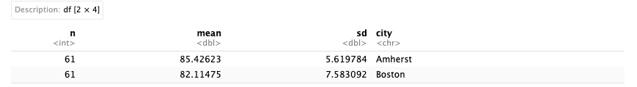
Methods
Estimate parameters for both data
Make a sampling function to generate data frame ensuring
Amherst sampling is done with sample from distribution
Boston sampling is done with sample from distribution + true difference in means + difference in means for true data
Input arguments: data parameters & true difference

Slide 14
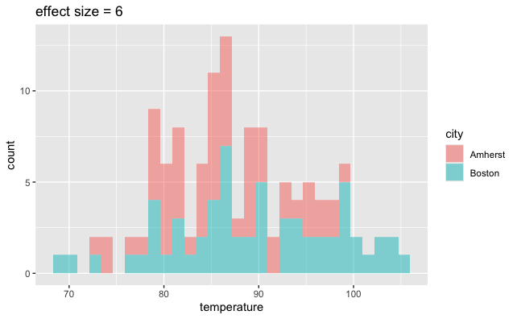
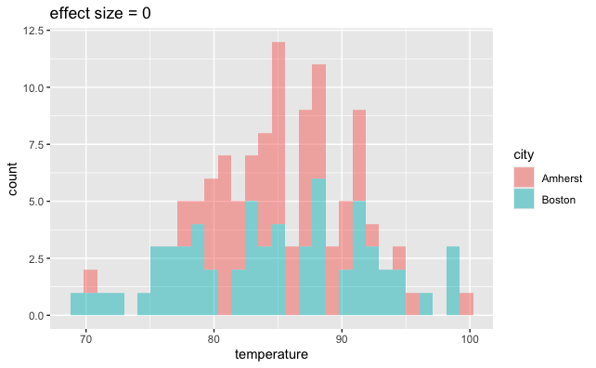
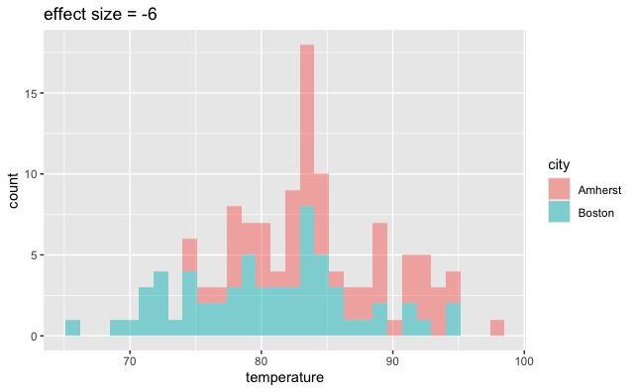
Methods
Using estimated parameters & Effect size = {-6,0,6}
alpha = 0.05

Slide 15
Methods
Find Power of the t-test
This is accomplished with M = 2000 and alpha = 0.05
Estimate the test at each iteration and return
1 for p_value < alpha
0 otherwise
Estimate the probability of drawing 1’s ; Which is the Power of the test:
P = sum(1’s)/M
Conduct a Power Study:
This is accomplished by varying the true difference parameter in the range [-6 , 6] with constant difference of 0.5

Slide 16
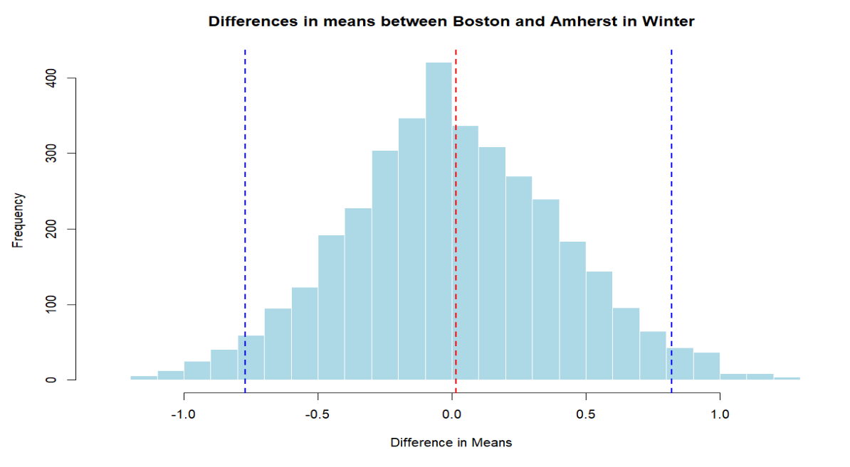
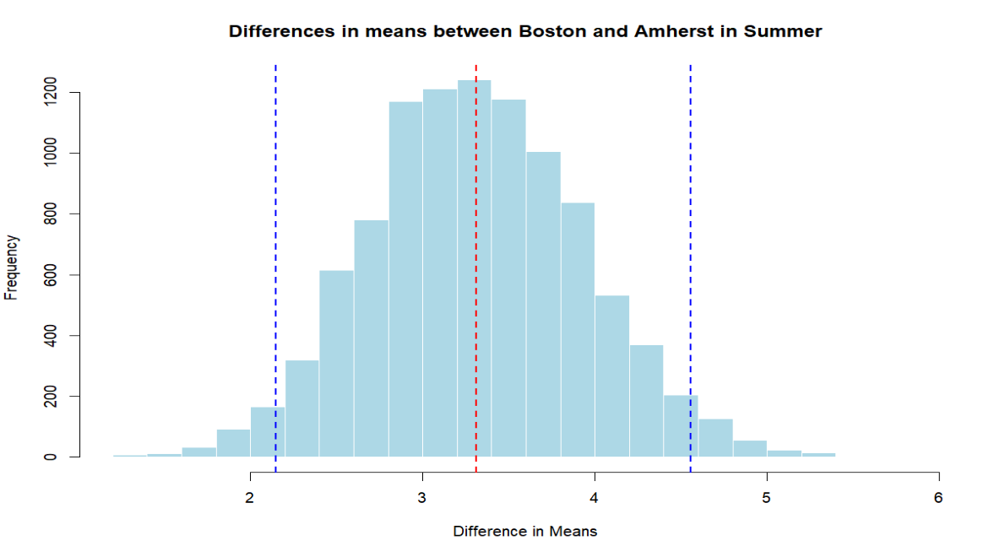
Results & Discussion
Winter 95% CI: [-0.77, 0.82]
Summer 95% CI: [2.15, 4.56]
Based on this, the bootstrap says that there is no significant difference in winter and a significant difference in the summer.
Notes:
Marco

Slide 17
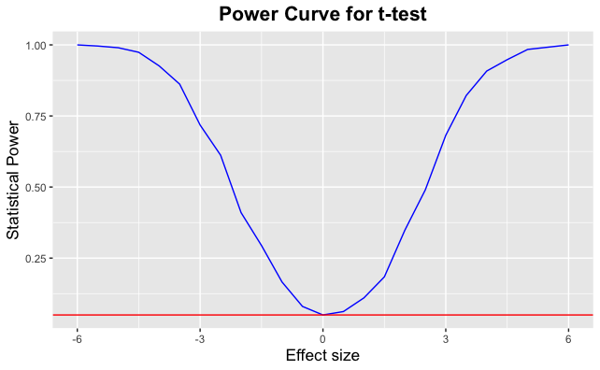
Results & Discussion

Slide 18
Results & Discussion
Study shows:
Test is most sensitive to large differences in mean temperatures.
Power is high as effect size approaches extremes
Power reduces as effect size approaches zero
Implication:
Smaller temperature difference between the two locations are less likely to be detected as significant.
It is a critical consideration for climatological studies that focus on subtle but potentially important differences.
Notes:
Shumeng

Slide 19
Conclusion
Conclusion:
The findings of this study for the summer data are robust, indicating that the
observed differences are unlikely to be due to chance. Such temperature differences could be attributed to various geographical and meteorological factors.
For example, Boston's coastal proximity could cool its climate during the summer, whereas Amherst, being further inland, may experience warmer weather.
These variations have implications for urban planning, agriculture, and energy management in both regions.
The results of the power study suggest that while major temperature differences are readily detected, smaller variations might not always be identified, highlighting the need for enhanced sensitivity in measurement and analysis.
Notes:
Shumeng

Slide 20
Thank you

